Slide 1
The 2018–2019 Ebola outbreak in North Kivu, the Democratic Republic of the Congo
Dr Janet Diaz

Slide 2
Background
In 2018-2019, WHO implemented a standardized data collection system, using REDCap, to capture clinical and epidemiological data on individual Ebola Virus Disease (EVD) cases.
The objective was to systematically describe case characteristics, clinical presentation, and outcomes across affected regions.
This system supports timely analysis and harmonization of EVD data across multiple outbreaks and countries.
I don’t have much – we can ask Janet to add one slide?

Slide 3
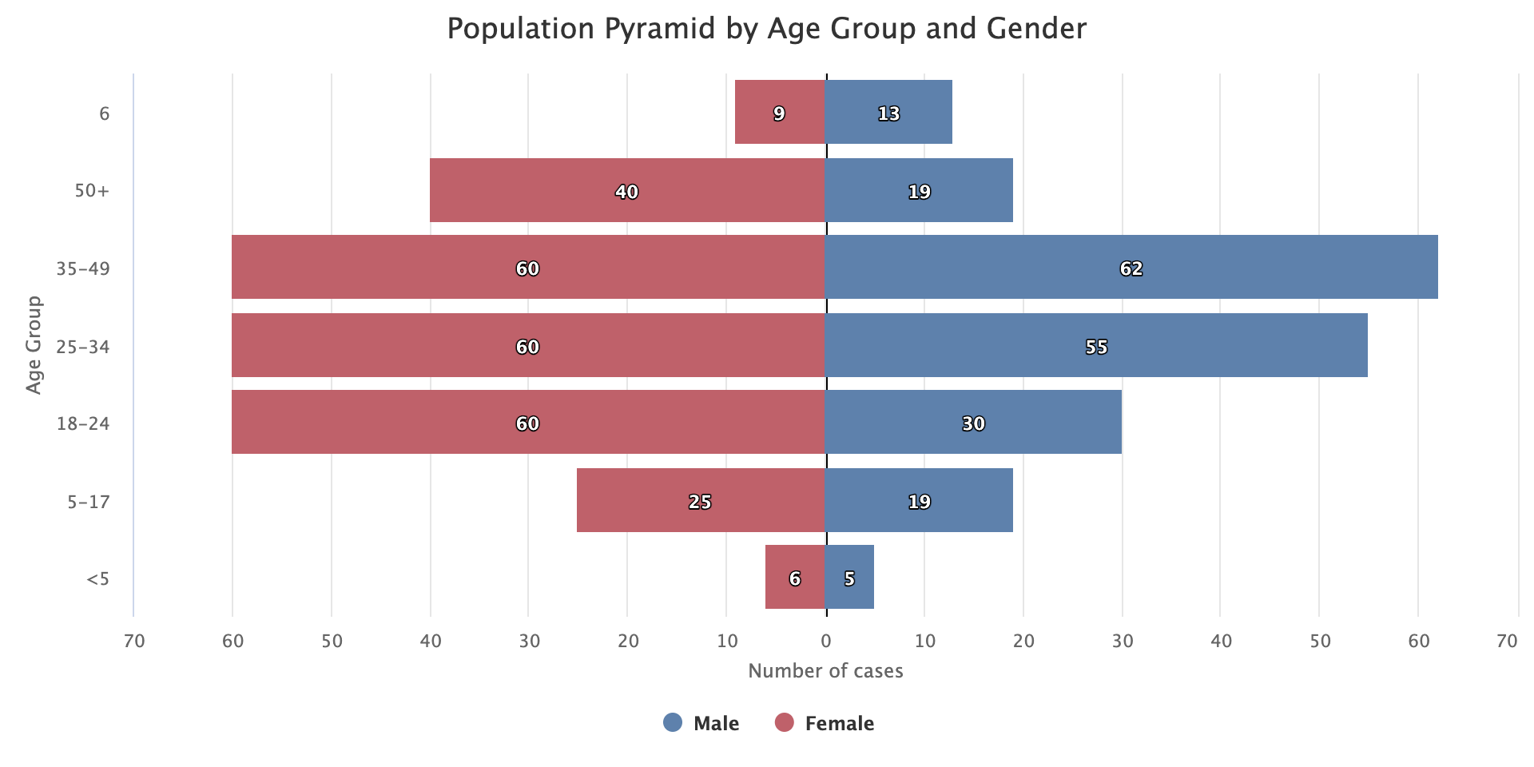
Cohort
A total of 463 confirmed cases admitted from 2018-08-05 to 2019-07-15 were entered in the database.
56% women and 2% children ≤5 years .
150 confirmed deaths reported for an average CFR of 32%.

Slide 4
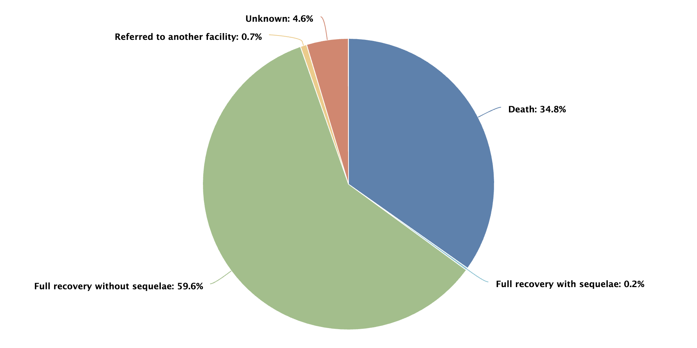
Cohort
A total of 463 confirmed cases admitted from 2018-08-05 to 2019-07-15 were entered in the database.
56% women and 2% children ≤5 years .
150 confirmed deaths reported for an average CFR of 32%.

Slide 5
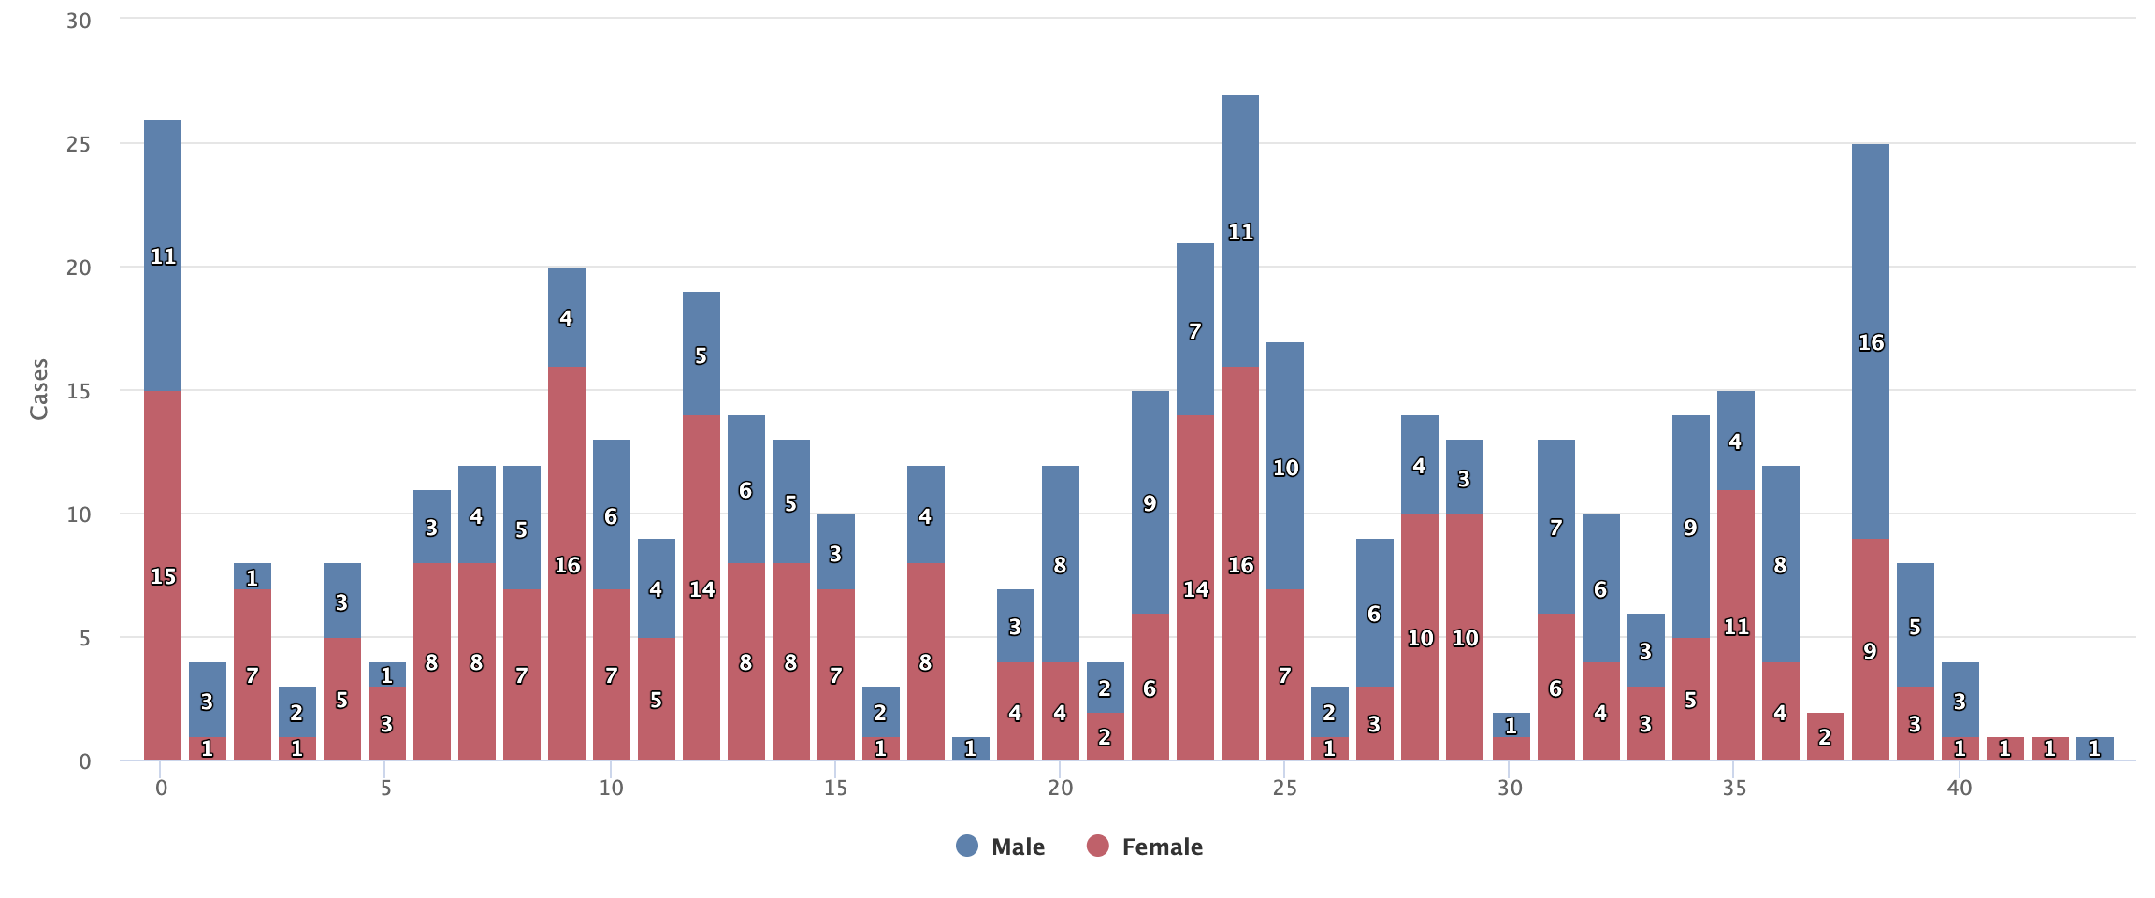
Epidemic Curve by Sex

Slide 6
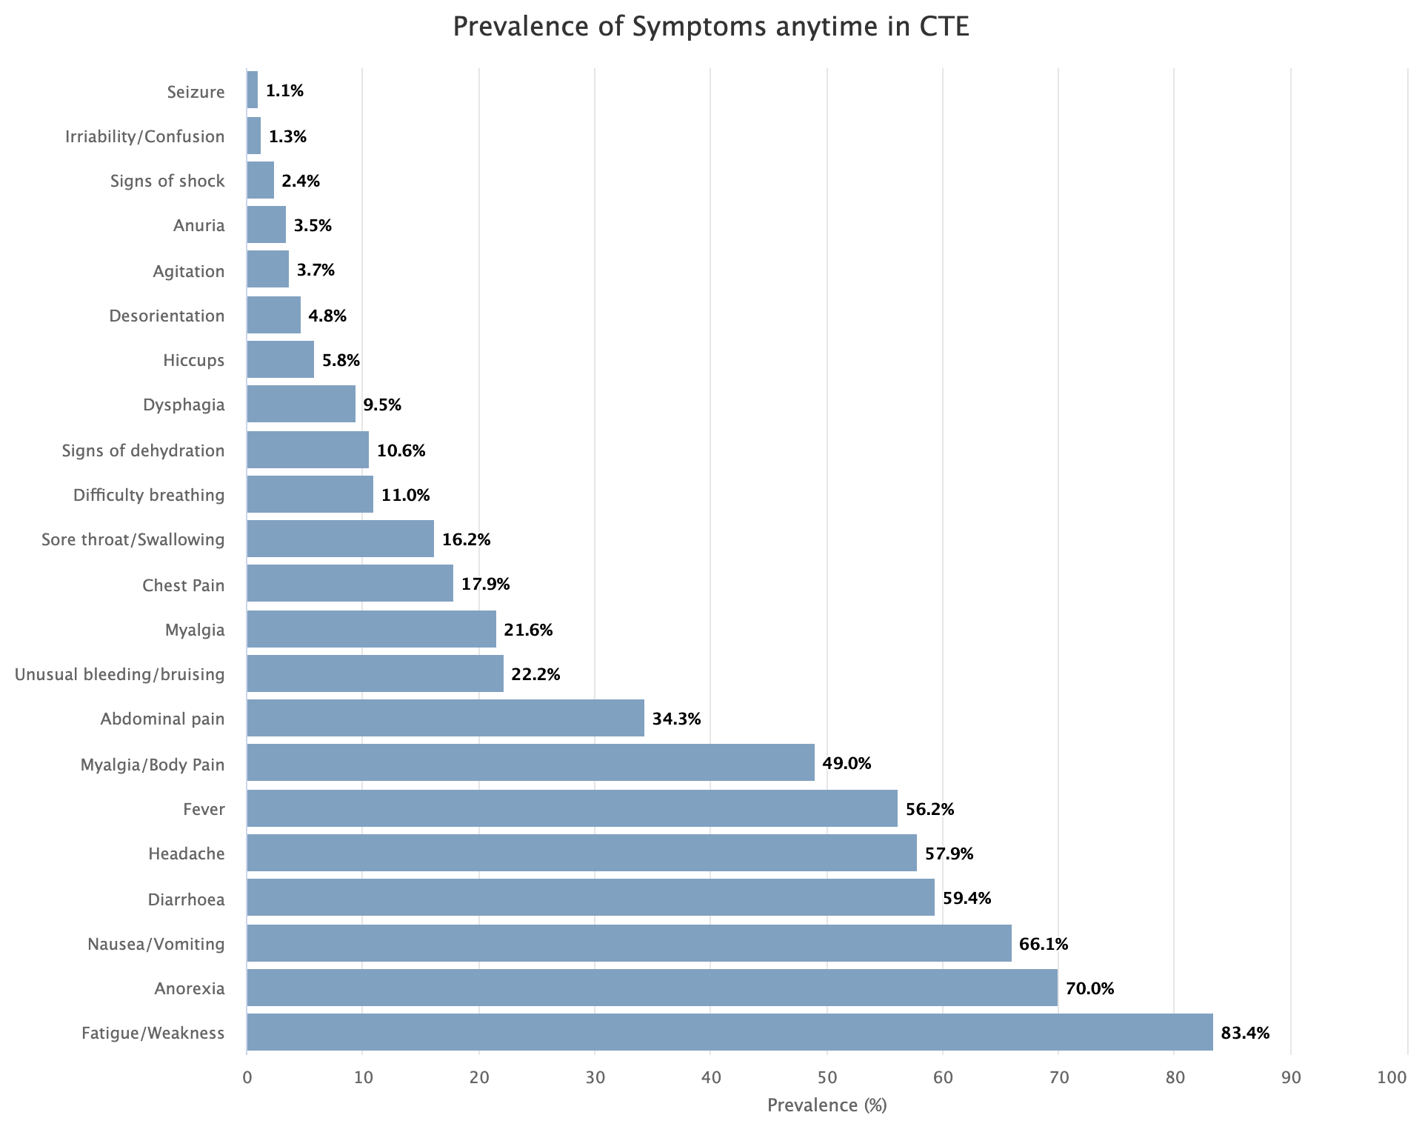
Cases Description
Symptoms.

Slide 7
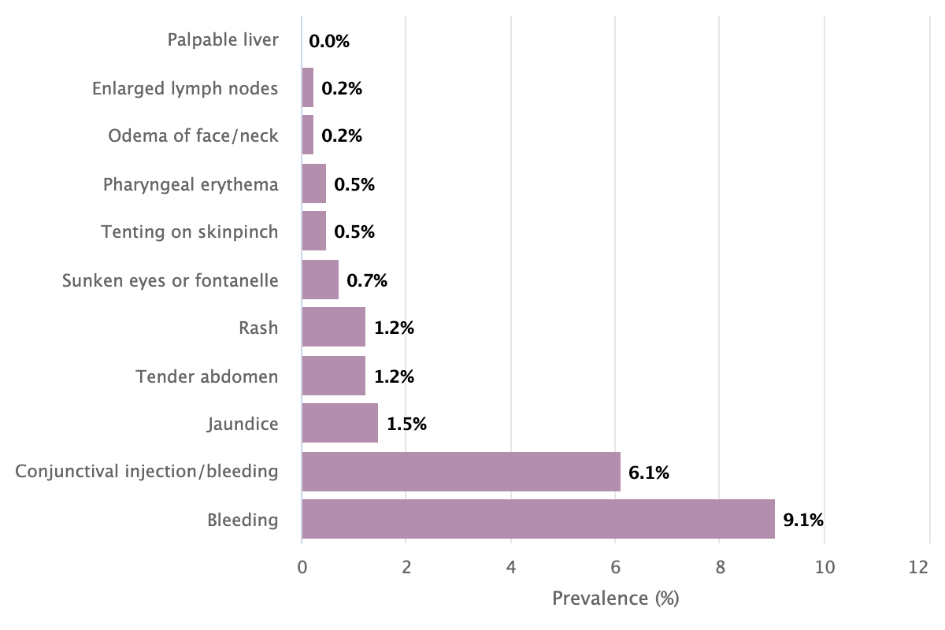
Cases Description
Clinical Signs.
Note: Bleeding (any site) was reported in 22 (14.7%) patients who deceased and 15 (5.8%) of those who recovered.

Slide 8
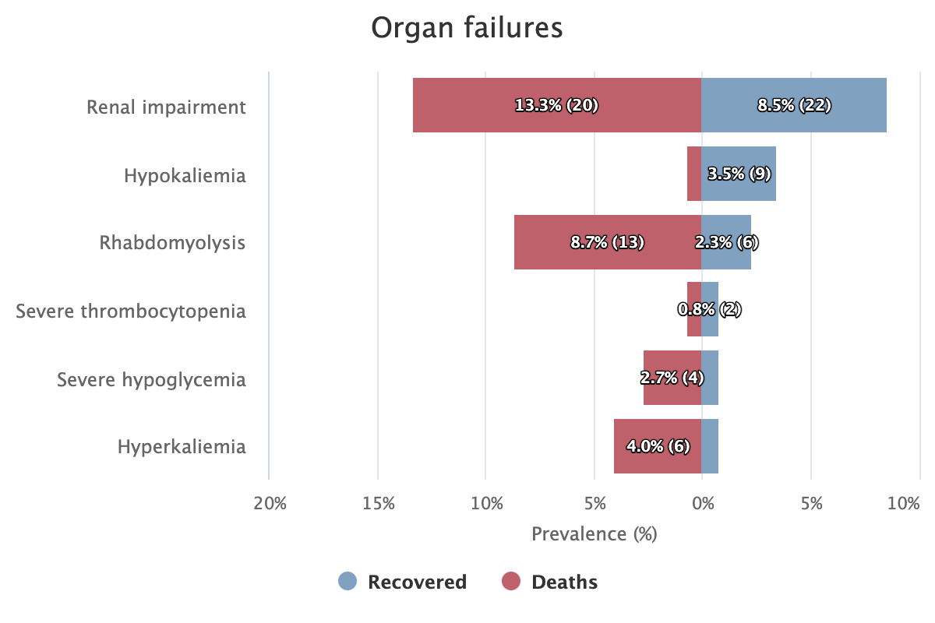
Cases Description
Complications.

Slide 9
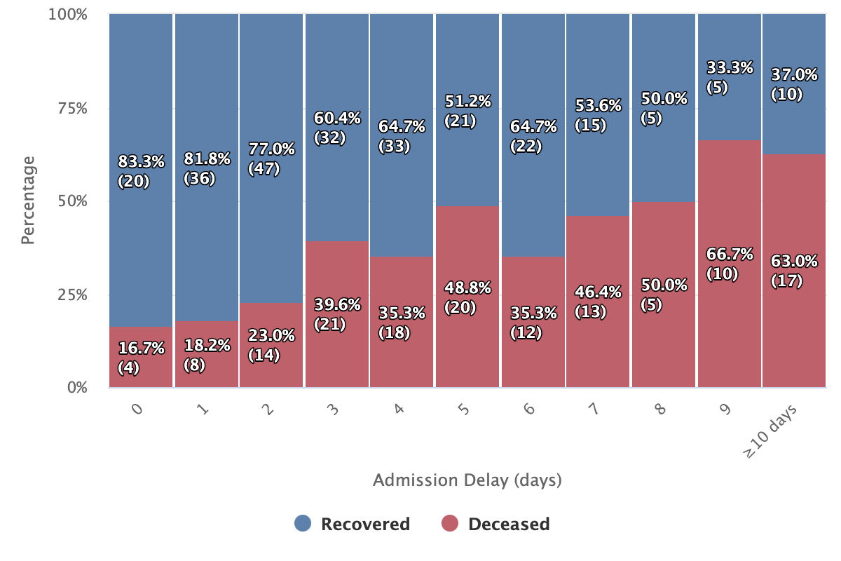
Outcomes and Admission Delay
Patients who deceased had a significantly longer delay (median 5 days – IQR 4.5) as compared to those who recovered ( median 3 days – IQR 4)
Note: admission delay represents the number of days from onset to admission to the hospital.

Slide 10
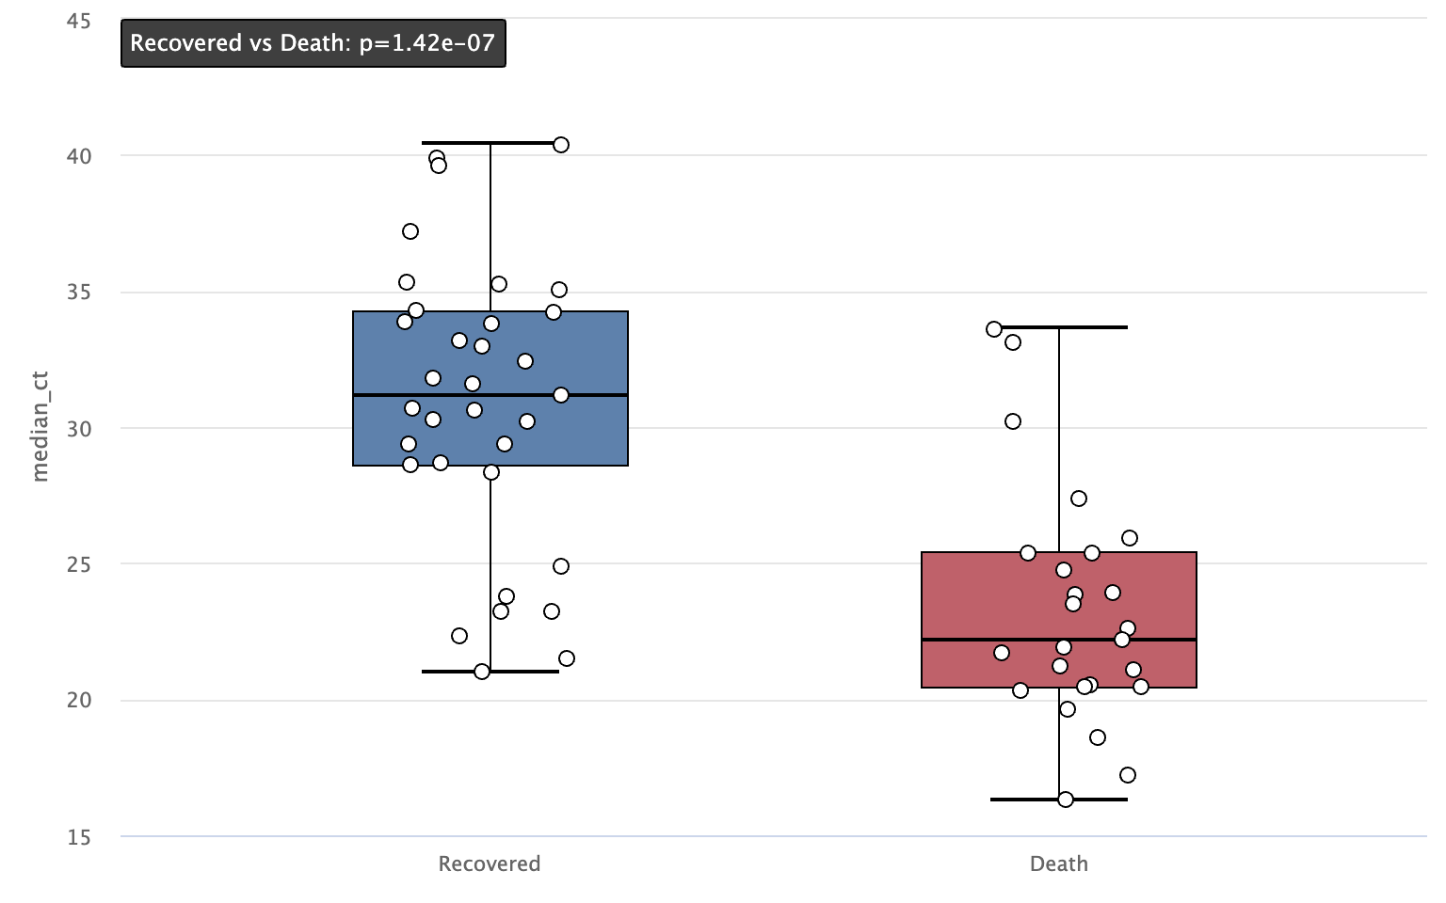
Outcomes and Initial Ct
Ct at admission was significantly lower among patients who deceased (median 22.2) as compared to those who recovered ( median 31.1)

Slide 11
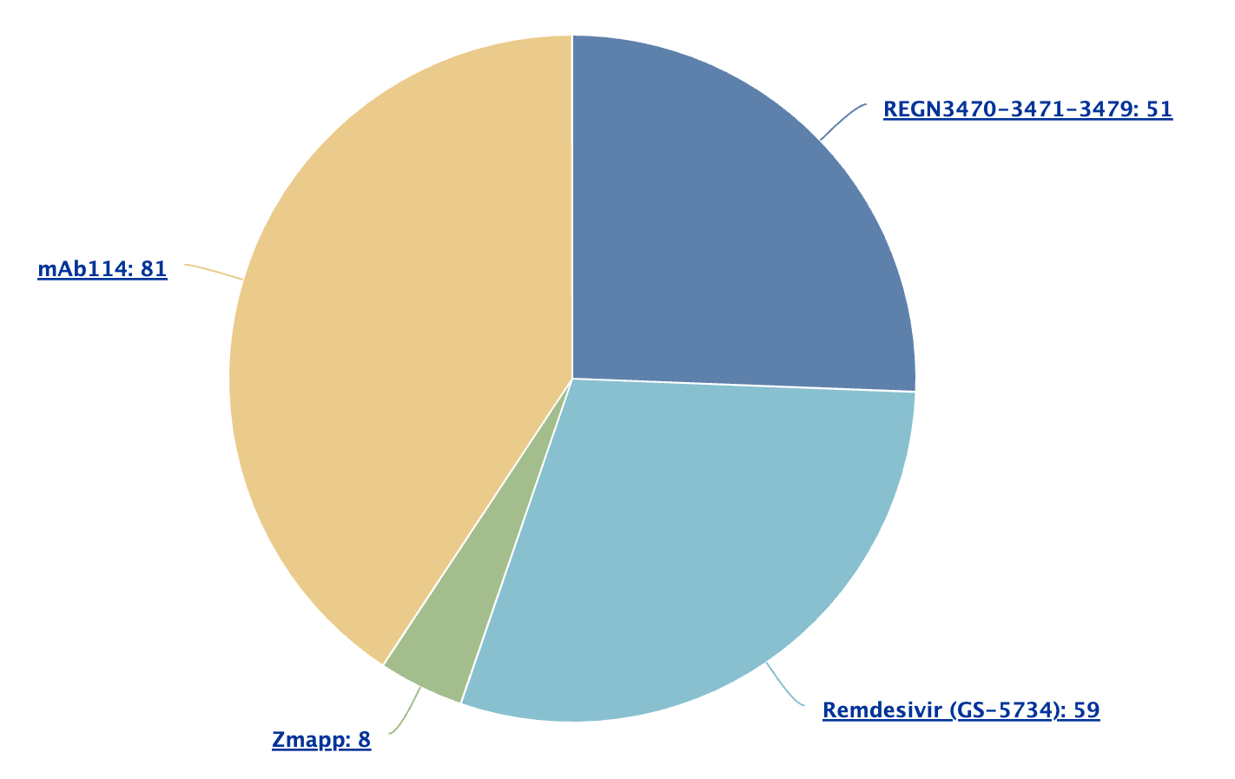
Treatments
@jamie: Add a context comment?
N=8 for Zmap (to discuss in model results)

Slide 12
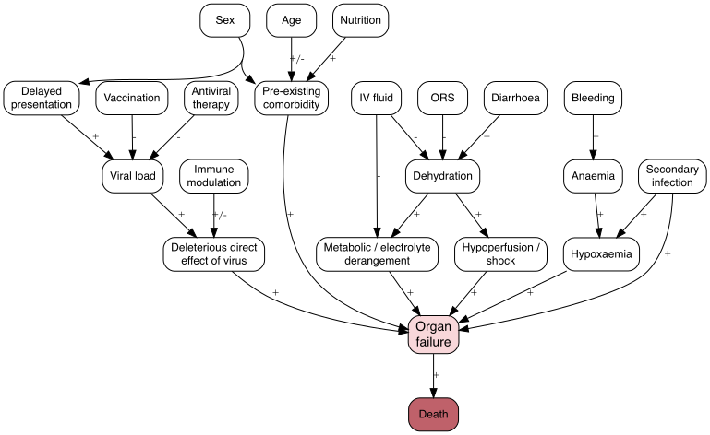
Predictors of EVD Outcomes and Complications
The Directed Acyclic Graphs (DAG) illustrates hypothesized causal relationships underlying EVD pathophysiology and clinical outcomes.
It served as a conceptual framework to guide, though not restrict, the selection of key variables included in the statistical models.

Slide 13
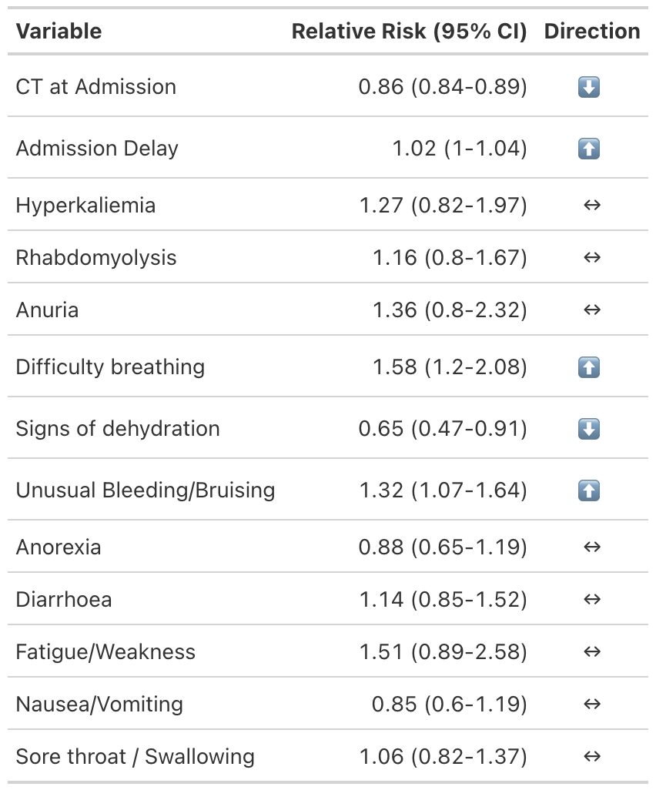
Independent Predictors of EVD Outcome (Adjusted Risk Ratios)
Multivariable Poisson regression with robust standard errors was used to estimate adjusted risk ratios (aRR) and 95% confidence intervals.
For each 1 Ct increase at admission, the risk of death decreased by 14% (RR 0.86).
For each day of delay at admission, the risk of death increases by 2% (RR 1.02).
@jamie note about dehydration?

Slide 14
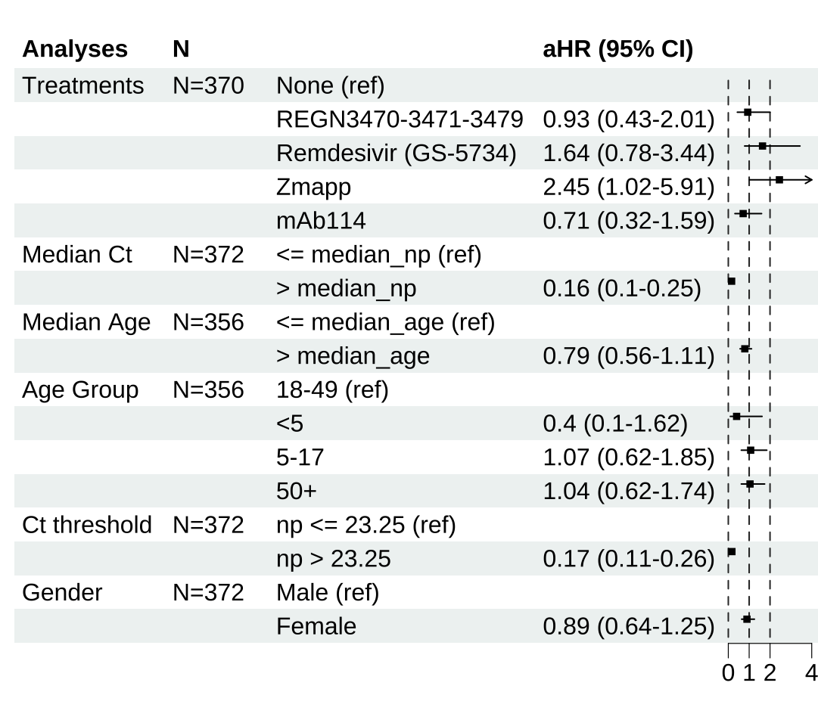
Relative Effects of Covariates on Survival Time
Adjusted hazard ratios (Weibull proportional hazards model).
HR > 1 → shorter survival;
HR < 1 → longer survival.
@jamie: I cut the pvalues.
Add one sentence on Zmapp (n=8)?

Slide 15
Thank you

